Slide 1

Hiring process analytics
By Rohit Paul

Slide 2
Overview
Hiring process is the most important and fundamental function of any organization.
As an data analyst, our job is to go through the data pointing out underlying trends (such as number of interviews & rejections, types of jobs, vacancies etc) and draw insights out of it.
These trends and insights helps the hiring team to works upon and make important decisions.

Slide 3
Approach
The datasheet is already provided for the project in .xlxs format.
After accessing the datasheet in excel a number of tasks are performed to understand and clean the datasheet. The tasks are:
Understanding the columns, data. Trying to get an overview of the data.
Removing missing data points.
Creating pivot tables and charts to analyze the data properly.
After the data in cleaned and pivot tables are created formulas are applied to get the required answers.
Charts are then prepared with the help of those pivot tables and and the values that are calculated previously.

Slide 4
Tech-stack used
To analyze the data and to create easily understandable charts Microsoft Excel & Power BI is used.
Later Google Slides in used to create this presentation.

Slide 5
Insights & Results

Slide 6
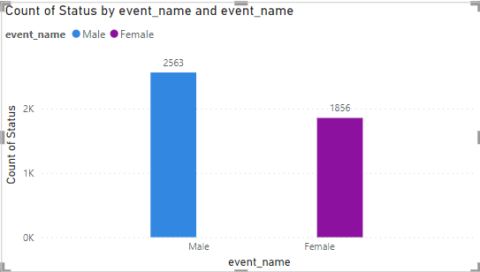
No. of Males and Females hired by the company
Number of males hired: Formula used: =countifs(event_name,”Male”,status,”Hired”)
=COUNTIFS(D:D,D2,C:C,C2)
Number of females hired: Formula used: =countifs(event_name,”Female”,status,”Hired”)
=COUNTIFS(D:D,D3,C:C,C2)
From the chart we can easily conduct a side-by-side comparison of males and females hired.

Slide 7
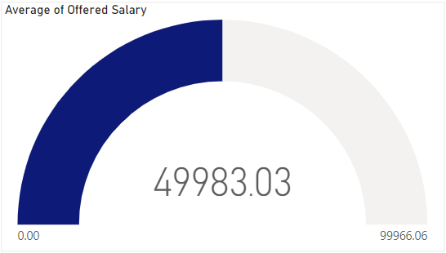
Average salary offered in this company
Average salary offered: Formula used: =average(offered_salary)
=AVERAGE(G:G)

Slide 8
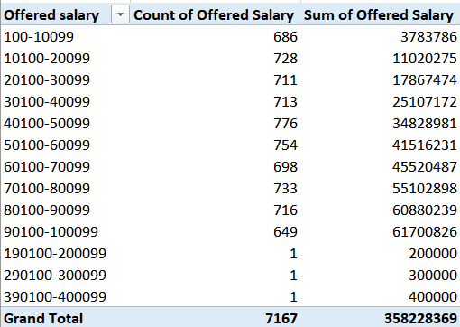
Draw class intervals for the salary in the company
Class intervals for salary: Class intervals helps us to shrink the data into a smaller table which helps a lot with readability of the data and also helps getting clearer insights. With the help of pivot table and group by function in Excel, class intervals could be easily made.

Slide 9
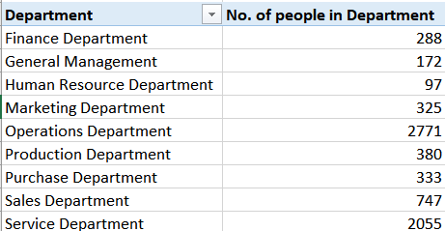
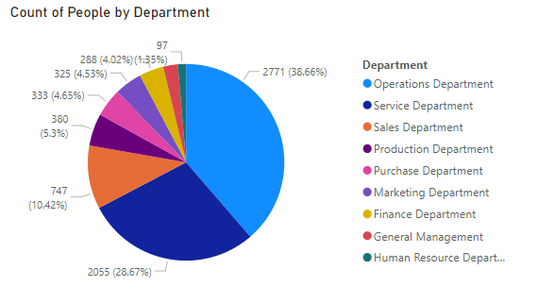
People working in different department
Pie-chart to represent proportion of people work in different department in the company: Pie-charts are one of the most unique way of representation to depict this type of data. We can get the required table from the pivot table or else we can use =countif() to calculate number of people working in different department.

Slide 10
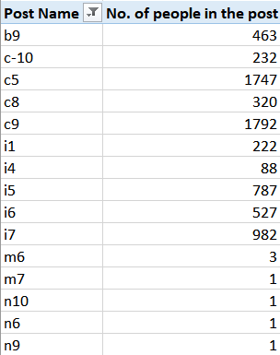
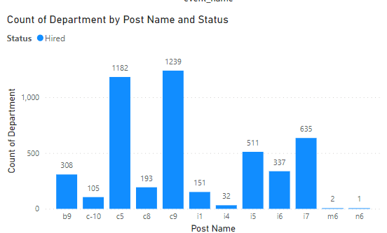
Represent different post tiers using chart
Representing the data using charts: Representing the data of a company is really important to understand the trend going in the company. We can get the required data for the chart from pivot table or by using the function =countif().

Slide 11
Conclusions
From above analysis we can draw a conclusion that, analysing the data and the charts helps understanding the trends in the hiring process:
From the salary interval table, we can have an insight of what are most commonly paid salary range and how much salary is paid in those range of salaries.
From the chart we can see which department has the most number of employees.
From the post tier chart we can have an insight of how many people are working under the posts.
All these insights and charts will help the hiring team to decide and take required steps to hire people for the company.

Slide 12
Thank You

